Slide 1

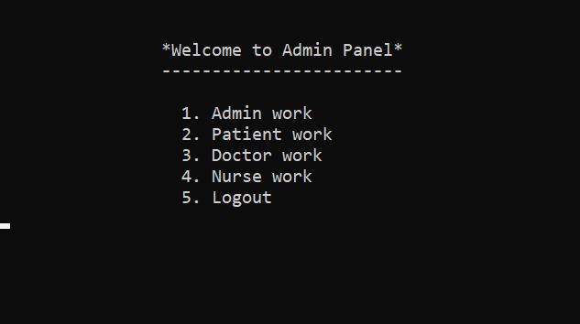
Hospital Management System
By team
Superman

Slide 2
Outline
Introduction
Software Includes
Stakeholders Analysis
Project Features
Package Diagram
Problem Statement
Showing Project
Timeline
Contributors

Slide 3
Introduction
The Software is for the automation of Hospital Management System
It maintains two levels of users:- Administration Level, User level

Slide 4
The Software
Includes
Admitting Patient
Maintaining Patient details
Managing Doctor details
Managing Nurse Info
Admin system that controls the whole functionality

Slide 5
Stakeholders
Analysis
Patients
Doctors
Stafs
Admin
The stakeholders in the Hospital are:

Slide 6
Project
Features
Patient CRUD operations
Doctor CRUD operations
Nurse CRUD operations
Admin Login System
Adding New admins

Slide 7
Package Diagram

Slide 8
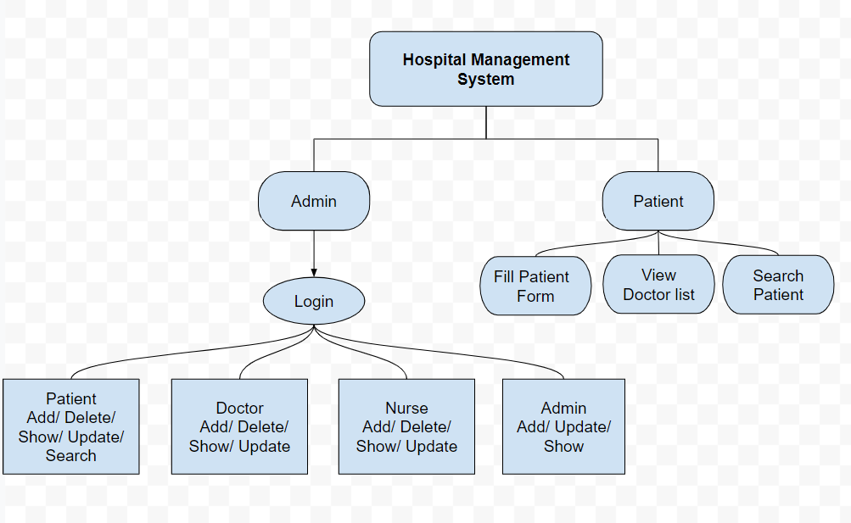
System workflow of Hospital Management System

Slide 9
Problem statement
Giving 24/7 help
Sometimes, people need help or answers in the middle of the night. Having a website means the information they need is always available and all in one spot, no need to call. This is especially important for hospitals, since sometimes patients need things like directions in a hurry.

Slide 10
What customers do today
Justification of our effort to try to solve the problem.
They can get informations about the hospital and get support at anytime and from anywhere they want.

Slide 11
Supporting information
82%
Users are constantly searching for a solution like this.
Explaining why we are focusing on this problem.

Slide 12
Time to Show Our Project

Slide 13
Next Steps

Slide 14
What next?
Present the timeline.
User testing plan.
Hands off

Slide 15
Timeline
AUG
SEPT
OCT
TODAY
DEC
Requirements gathering
User research
User testing
Review
Hands-off

Slide 16

Contributors
Team Superman:
ARIFUL ISLAM
KAZI TANJIMUL ISLAM
KHALED BIN KASHEM
MD. SADMAN SAKIB
SYED MAHMUDUL HASAN
TAKIB KHAN

Slide 17
Thanks for staying

